Slide 1
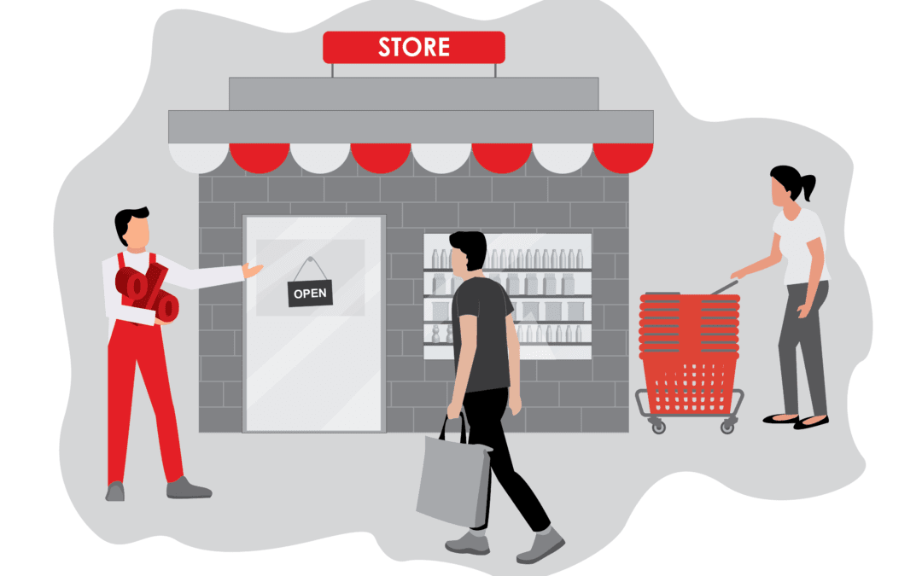
Home
RETAIL SALES
Customer Details
Dashboard Project
Analysis
Dashboard

Slide 2
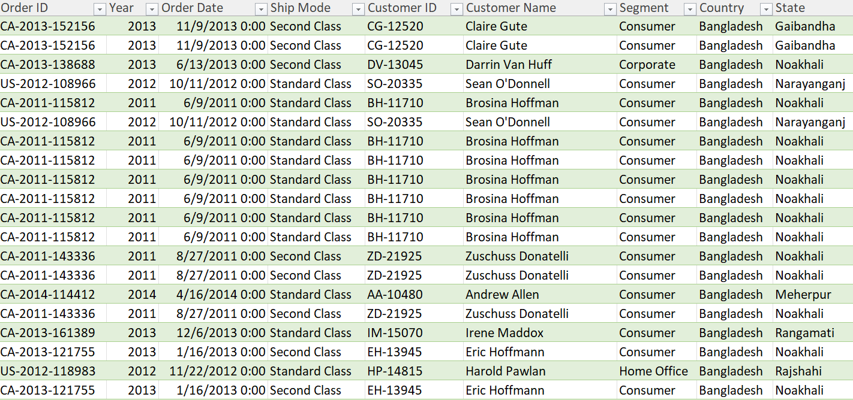
Home
Customer Details
Analysis
Dashboard

Slide 3
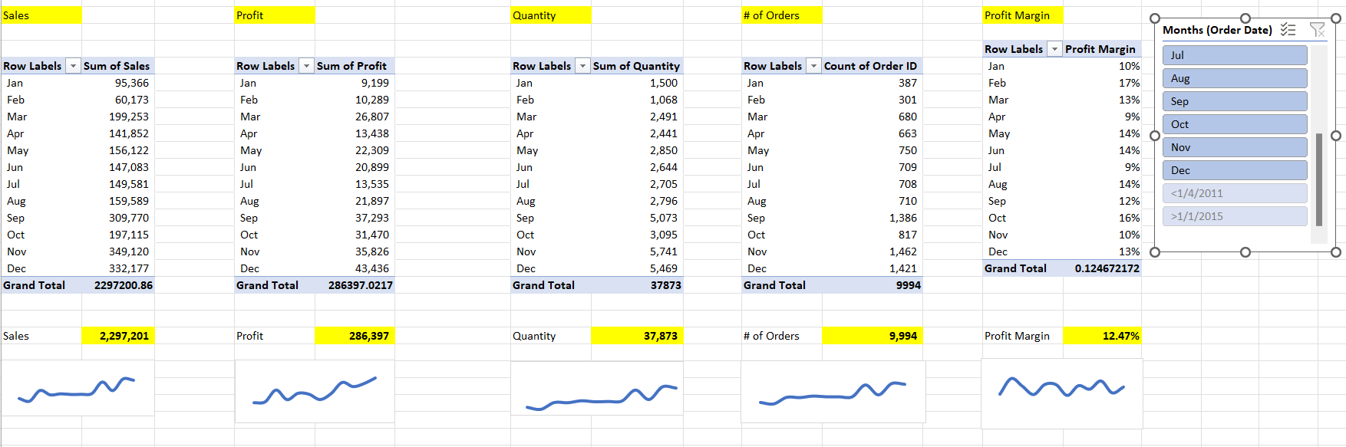
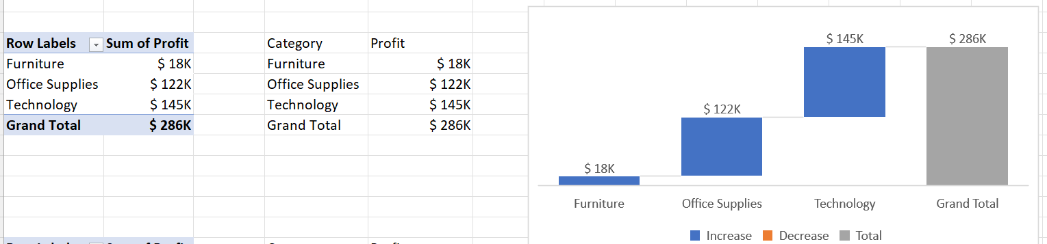
Home
Customer Details
Analysis
Dashboard

Slide 4
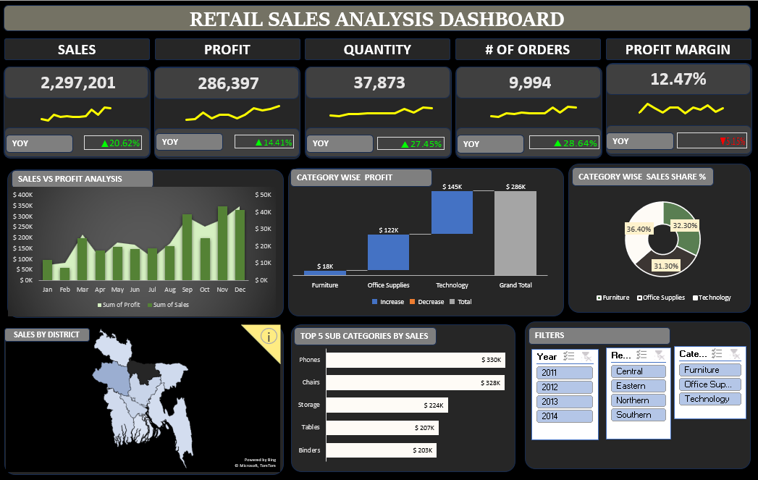
Home
Customer Details
Analysis
Dashboard

